Slide 1
MIPS 3
Julia abbott
Jude battista

Slide 2
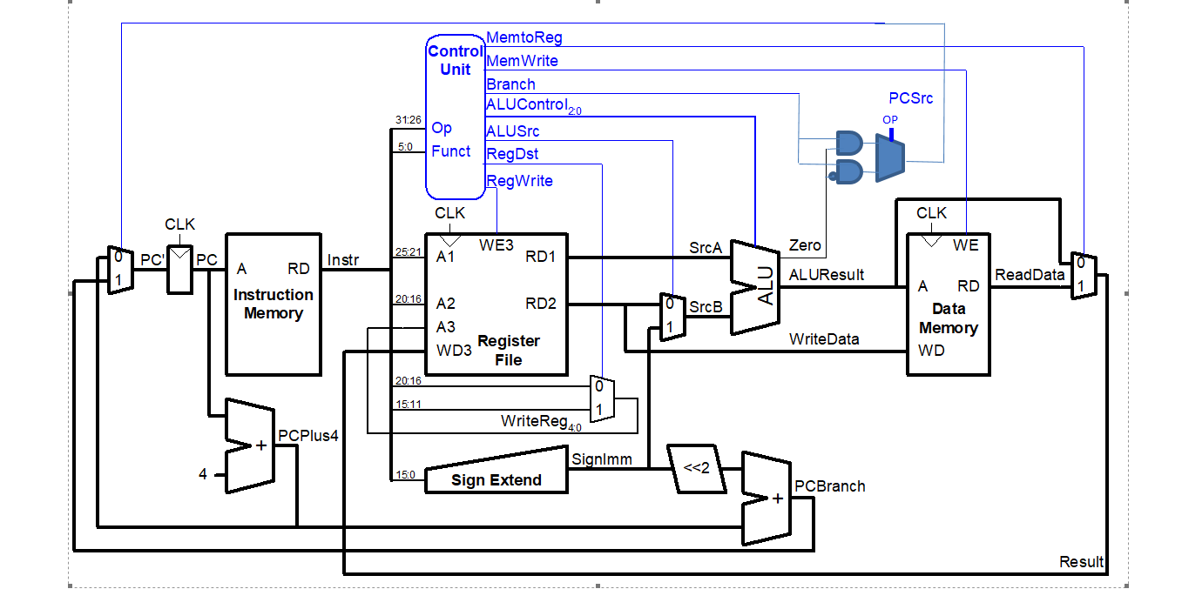
Changes made

Slide 3
Mips test program
addi $4, $0, 1 # mov 1 into $4
addi $5, $0, 1 # mov 1 into $5
bne $4, $5, end # should do nothing since $4 and $5 are equal
addi $5, $5, 1 # add one to $5, making it not equal to $4
bne $4, $5, testXori # should branch to the testXori section, skipping the jump to end
j end # skip the testXori section
testXori:
addi $4, $0, 3 # Set $4 to three
xori $5, $4, 6 # Do an xor with $4 = 3 and 6, should be 5 (...0011 XOR ...0110 = 0101 = 5)
end:

Slide 4


Slide 5
Vhdl chagnes
Imem1
signal mem: ramtype := InitRamFromFile("memfile_3.dat");
Md:maindec
when "001110" => controls <= "101000011"; --XORI
when "000101" => controls <= "0X010X001"; -- BNE
Ad:aludec
when "10" => alucontrol <= "011"; --xori
Mainalu:alu
a xor b when "11",
Cont: controller(struct)
pcsrc <= branch and not zero when op = "000101" else branch and zero;

Slide 6
Hex instructions
20040001 # addi
20050001 # addi – Registers are equal
14850005 # bne – DO not Branch
20a50001 # ADDi – Registers not equal
14850001 # BNE - Branch
08000008 # Should not execute
20040003 # ADDI
38850006 # XORI

Slide 7
process
Paired Programming
Assembler encryption and decryption
Turns out, your controller needs opcodes for the new instructions. Who knew?
Simulation periodically failed to acknowledge altered instruction set.
Yes, we tried that.
Simulation and FPGA results in agreement.

Slide 8
result
Yay?
We considered adding additional features.
We did not add additional features.
the current boss was tough enough without giving it power-ups.

